Slide 1
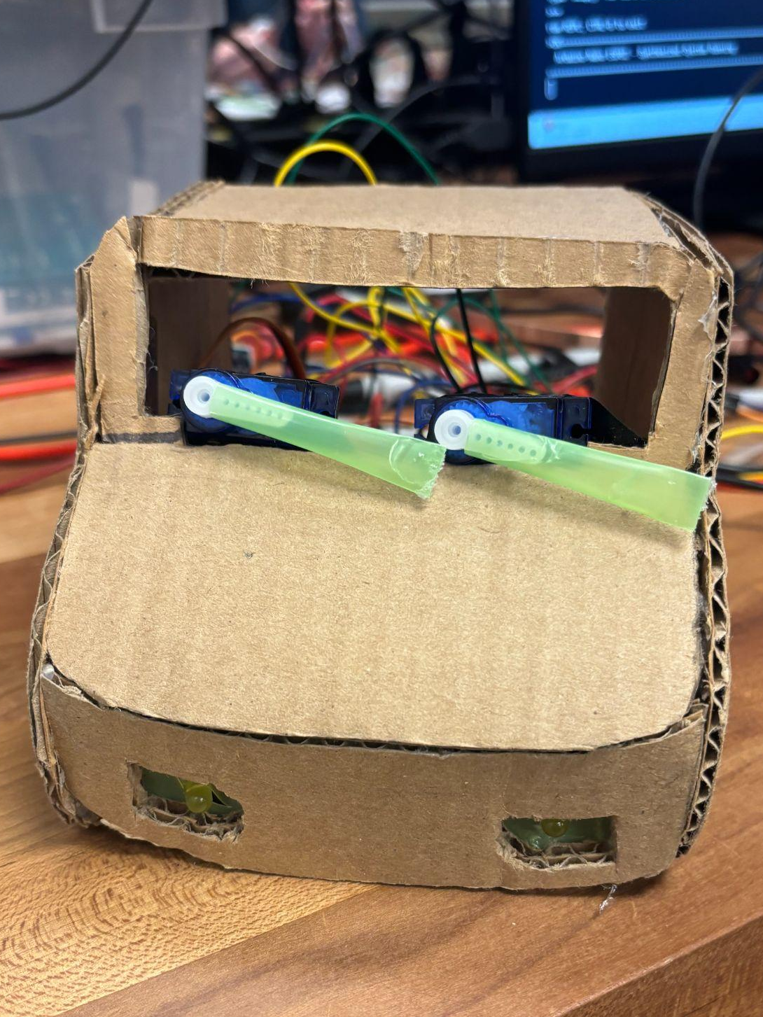
FYRE segment 1 project:
Auto-Wiper and
Headlight System
By Carter and Gwen

Slide 2
Intro and Project Overview

Slide 3

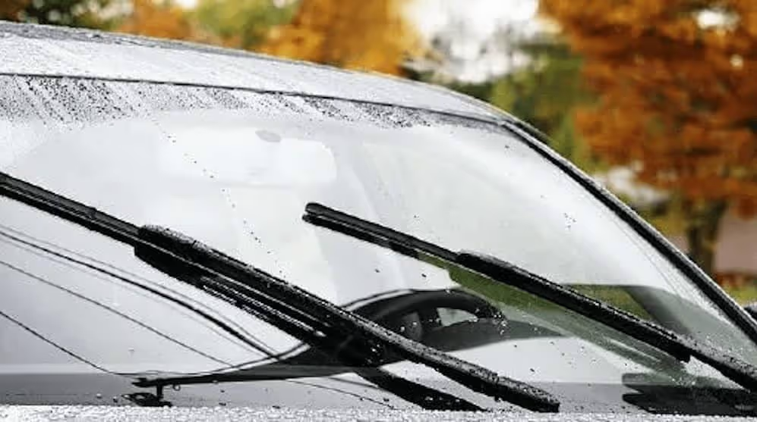
Goal: Make a prototype of an automatic headlight and windshield wiper system for a car
Purpose: Enhance driver
safety, visibility, and convenience at night and
during storms

Slide 4




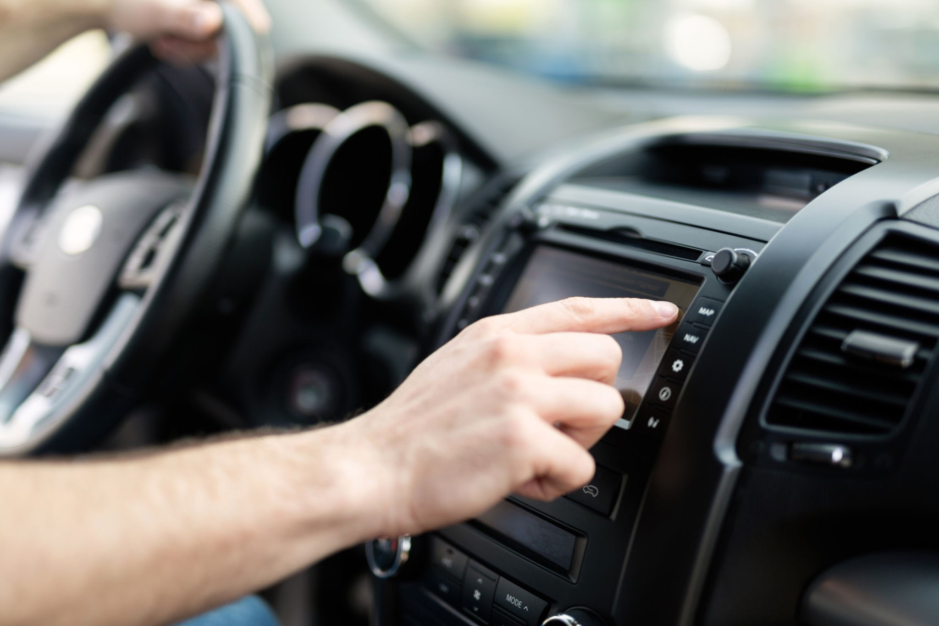
INPUTS
Light Sensor
light_mode
Moisture Sensor
water_drop
Button
touch_app

Slide 5


OUTPUTS
“Windshield Wiper” / Servos
light_mode
“Headlights” / LEDs
water_drop

Slide 6
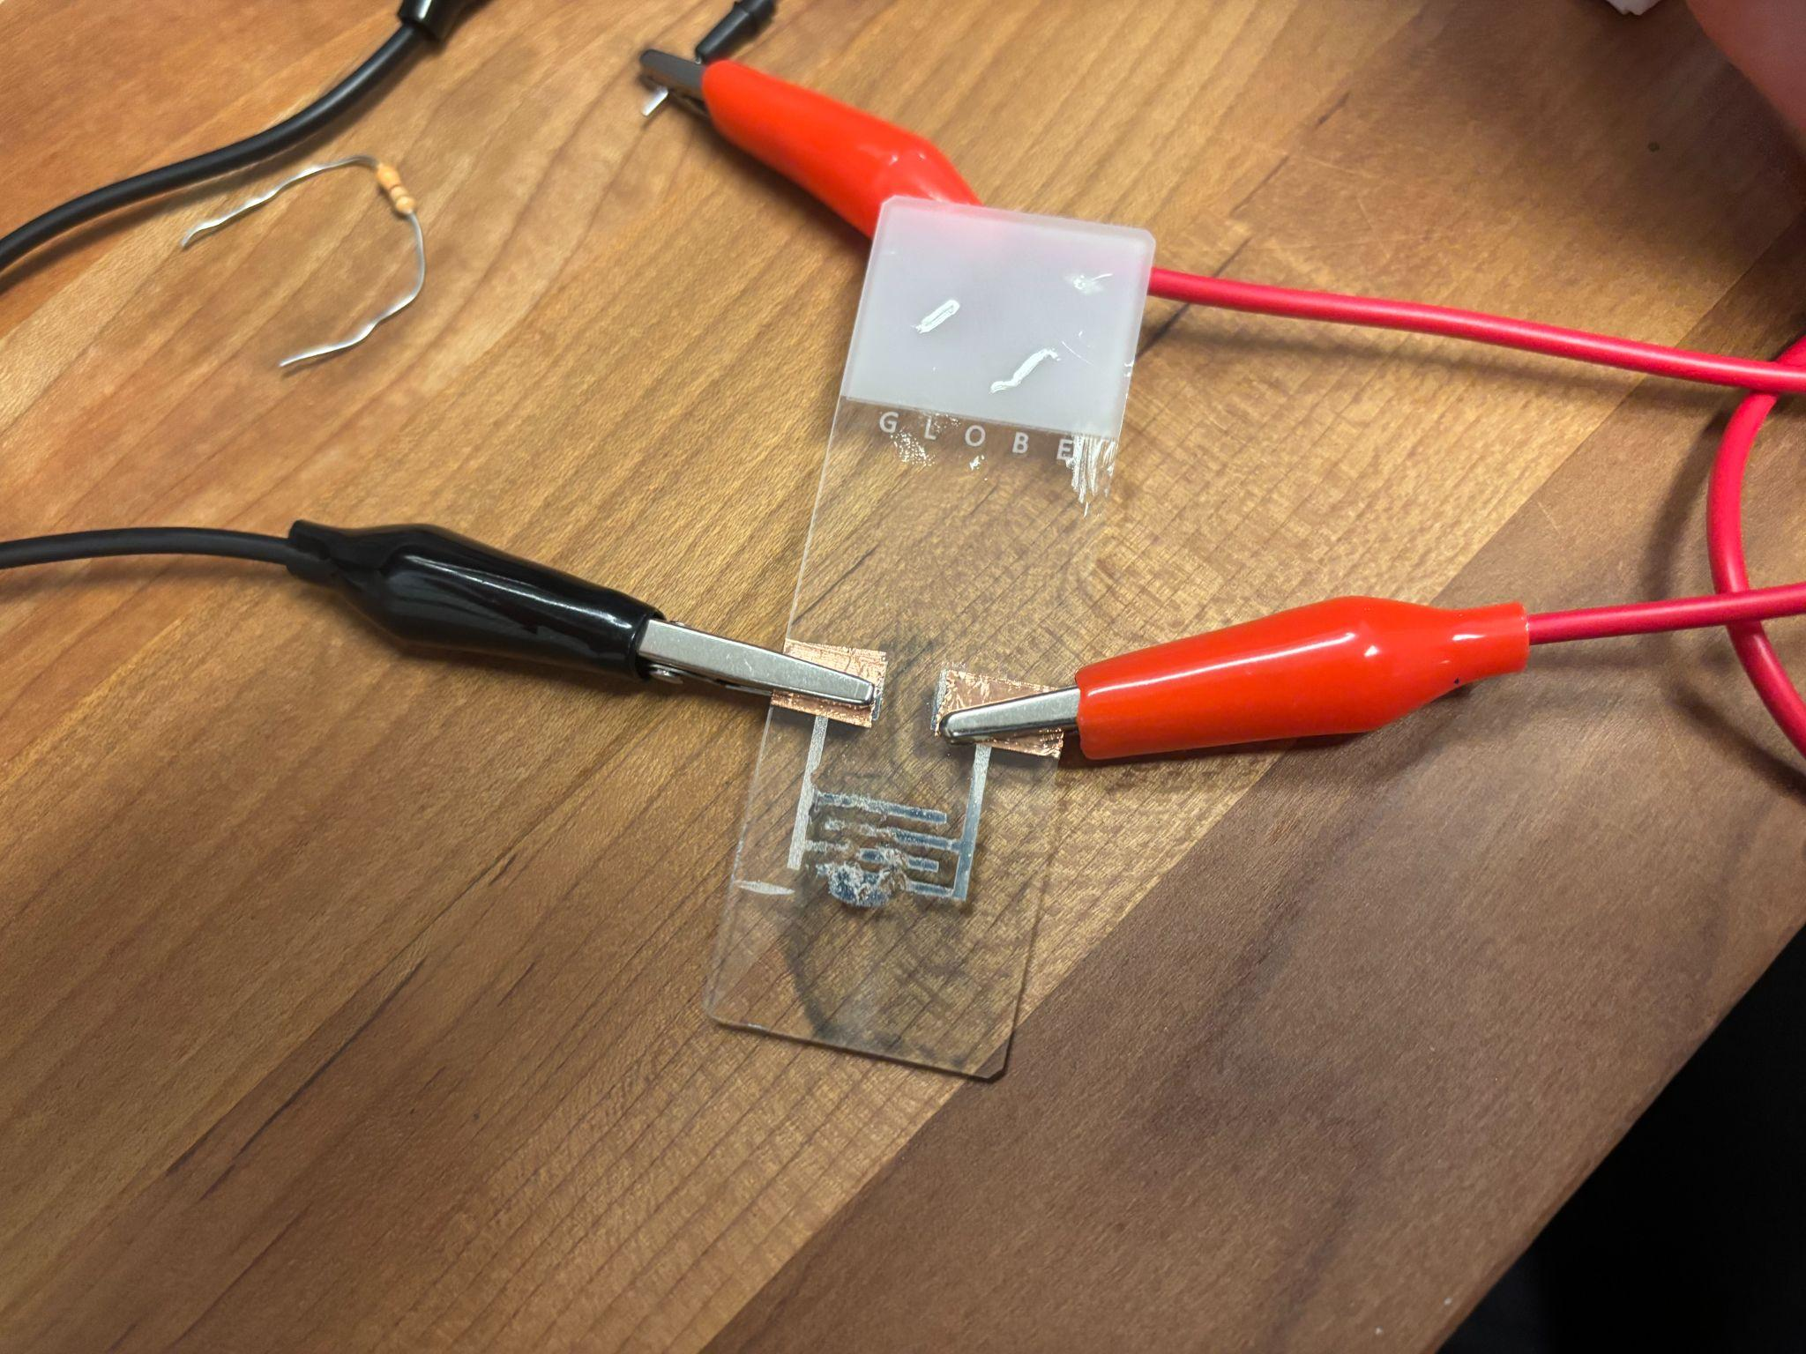
CONSTRAINTS
Must use breadboard and microcontroller
Incorporate homemade sensor
About a week of in-lab time

Slide 7
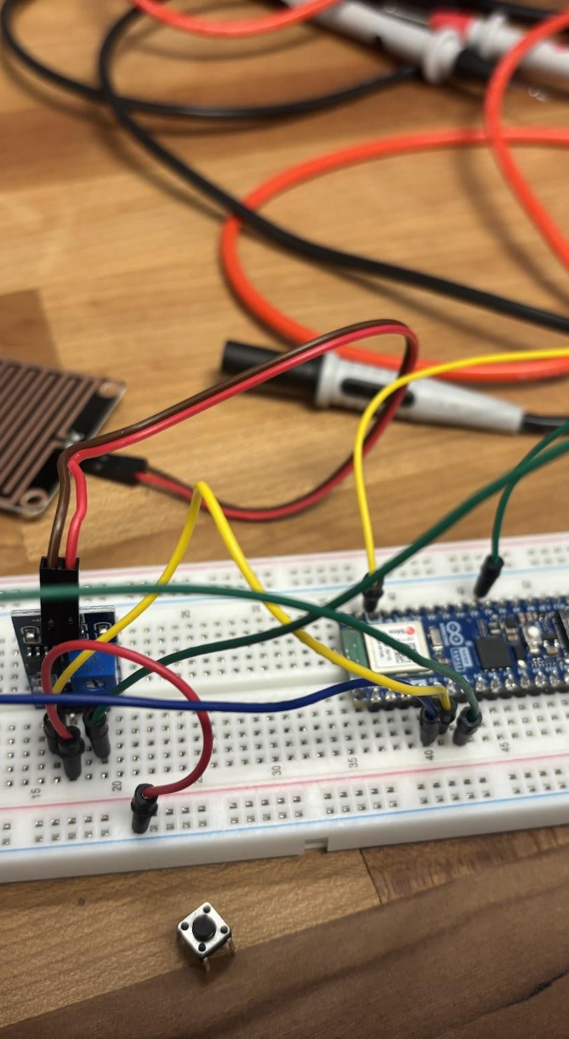
REQUIREMENTS
Must interact with other people
Prototype is designed to improve someone’s quality of life
Multiple inputs and outputs
Use AI to help develop the code
At least 1 LED
At least one additional element (button, light resistor, potentiometer, etc.)

Slide 8
Design Process

Slide 9
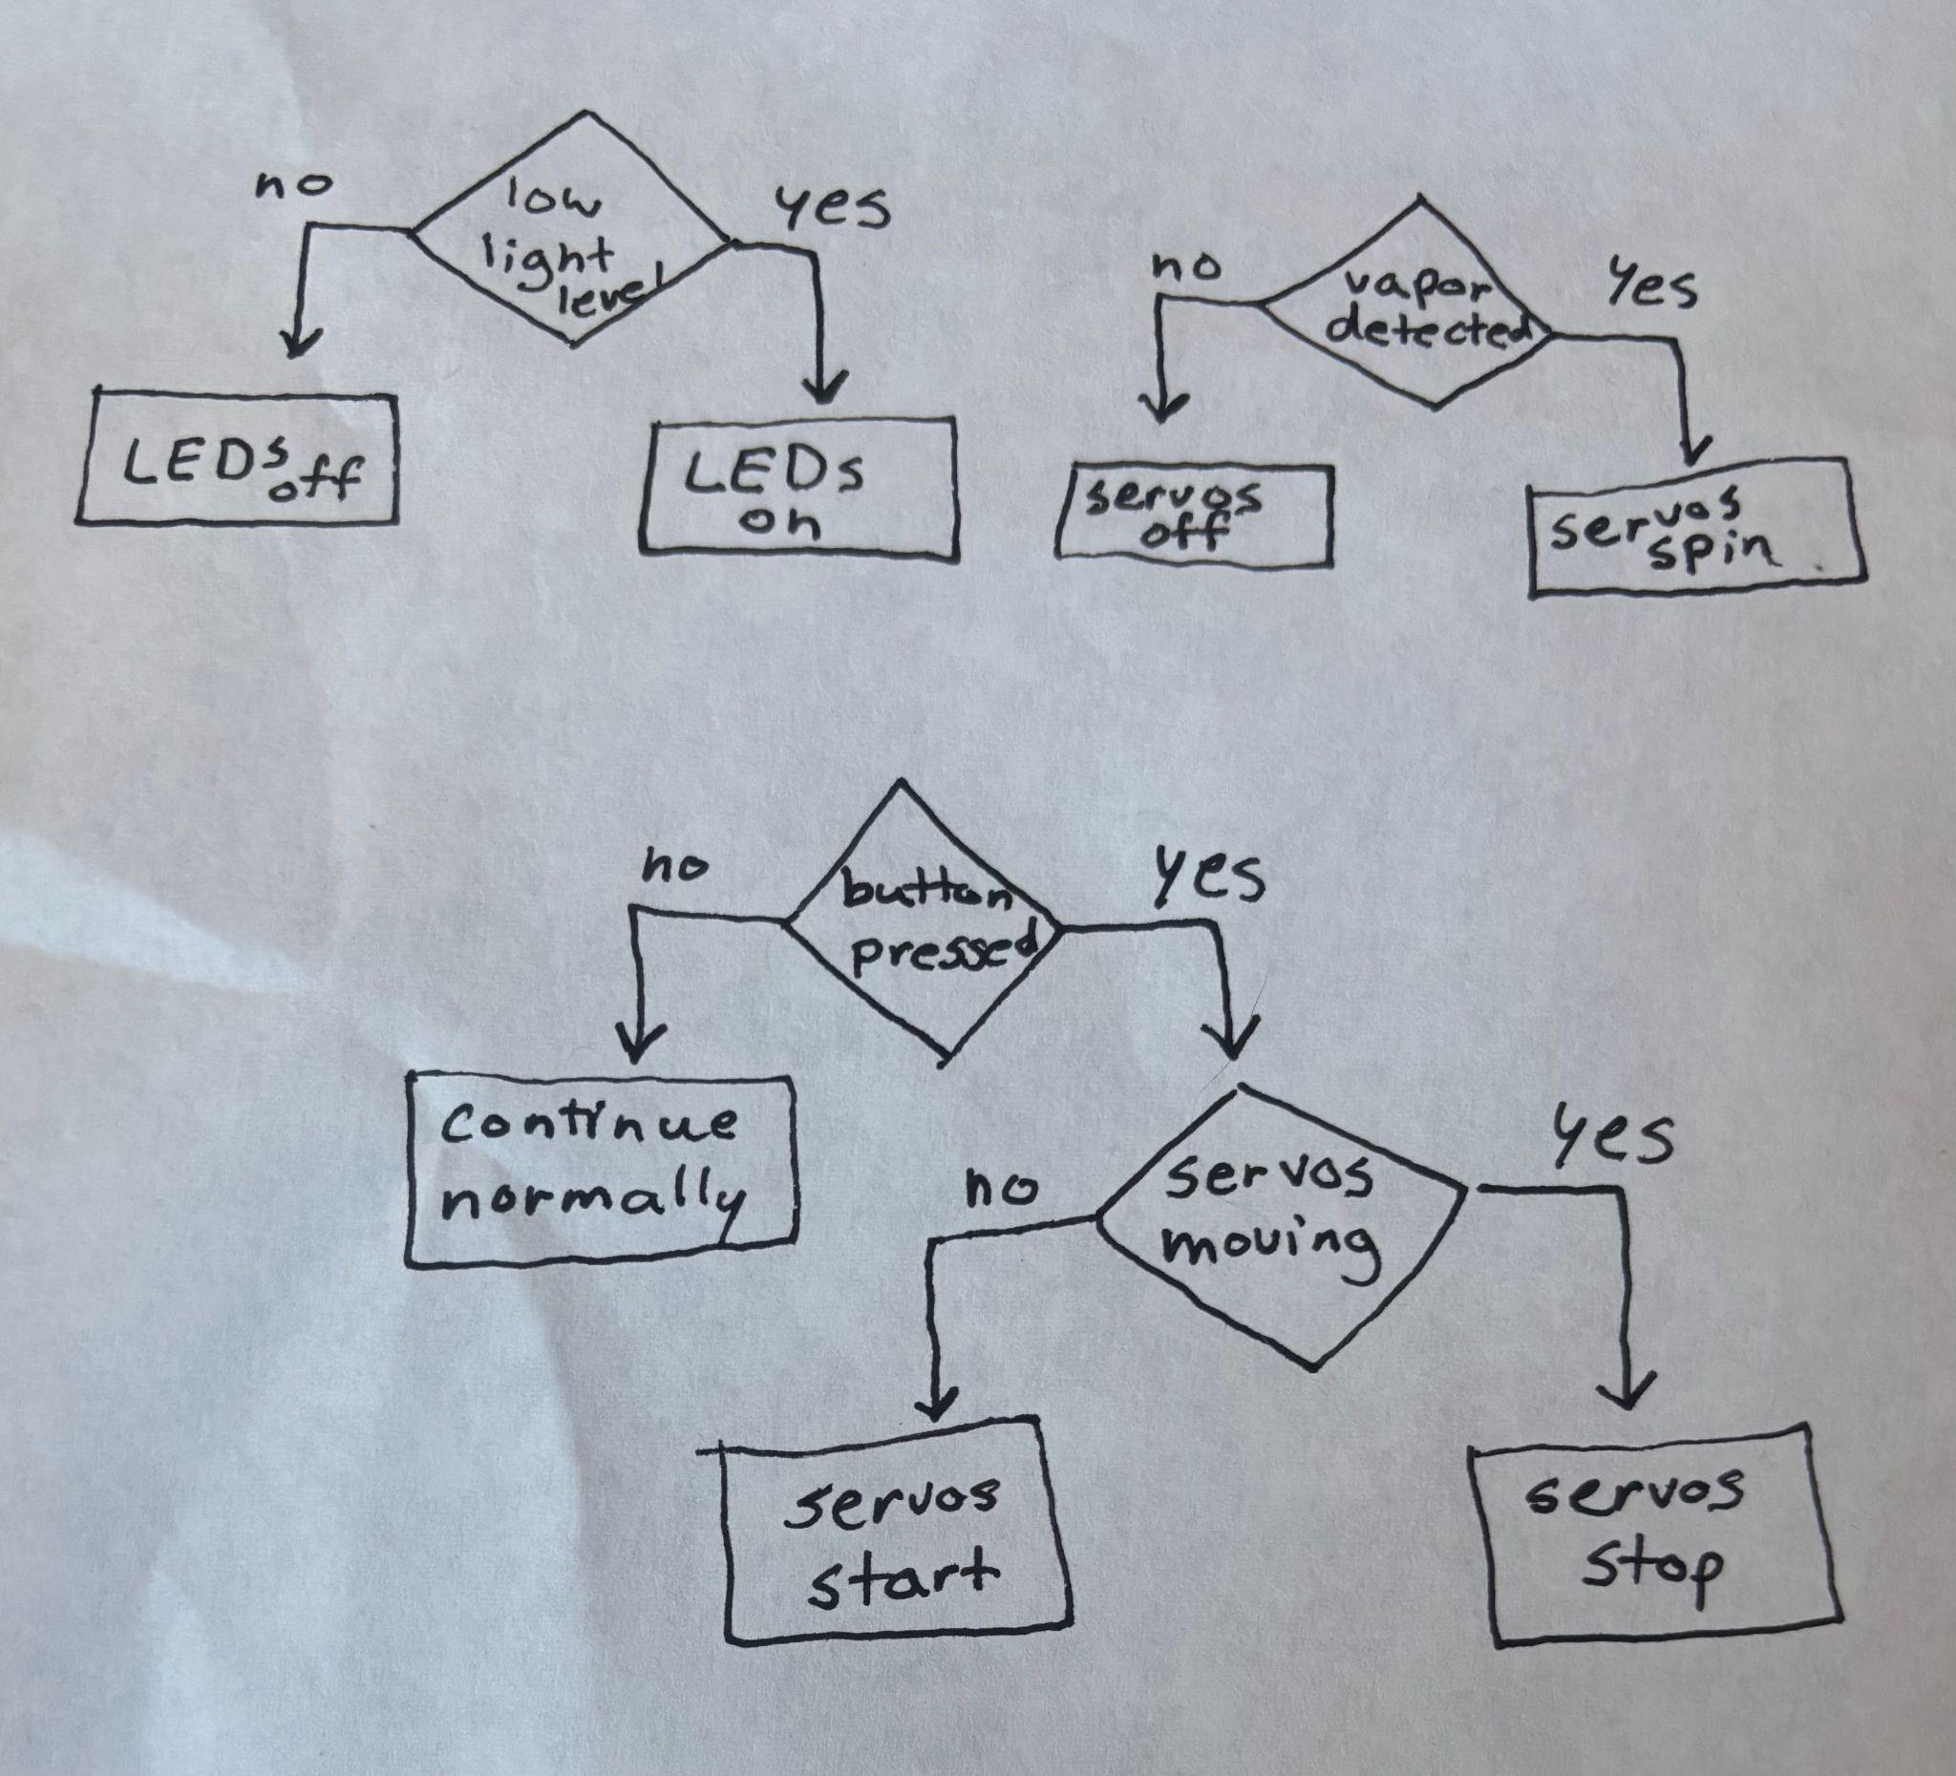
Step 1:
Component planning
Microcontroller
Servo motors (wipers) that go off when vapor detected
LEDS (headlights) that turn on when light gets low
Button for manual override
Made system flow chart

Slide 10
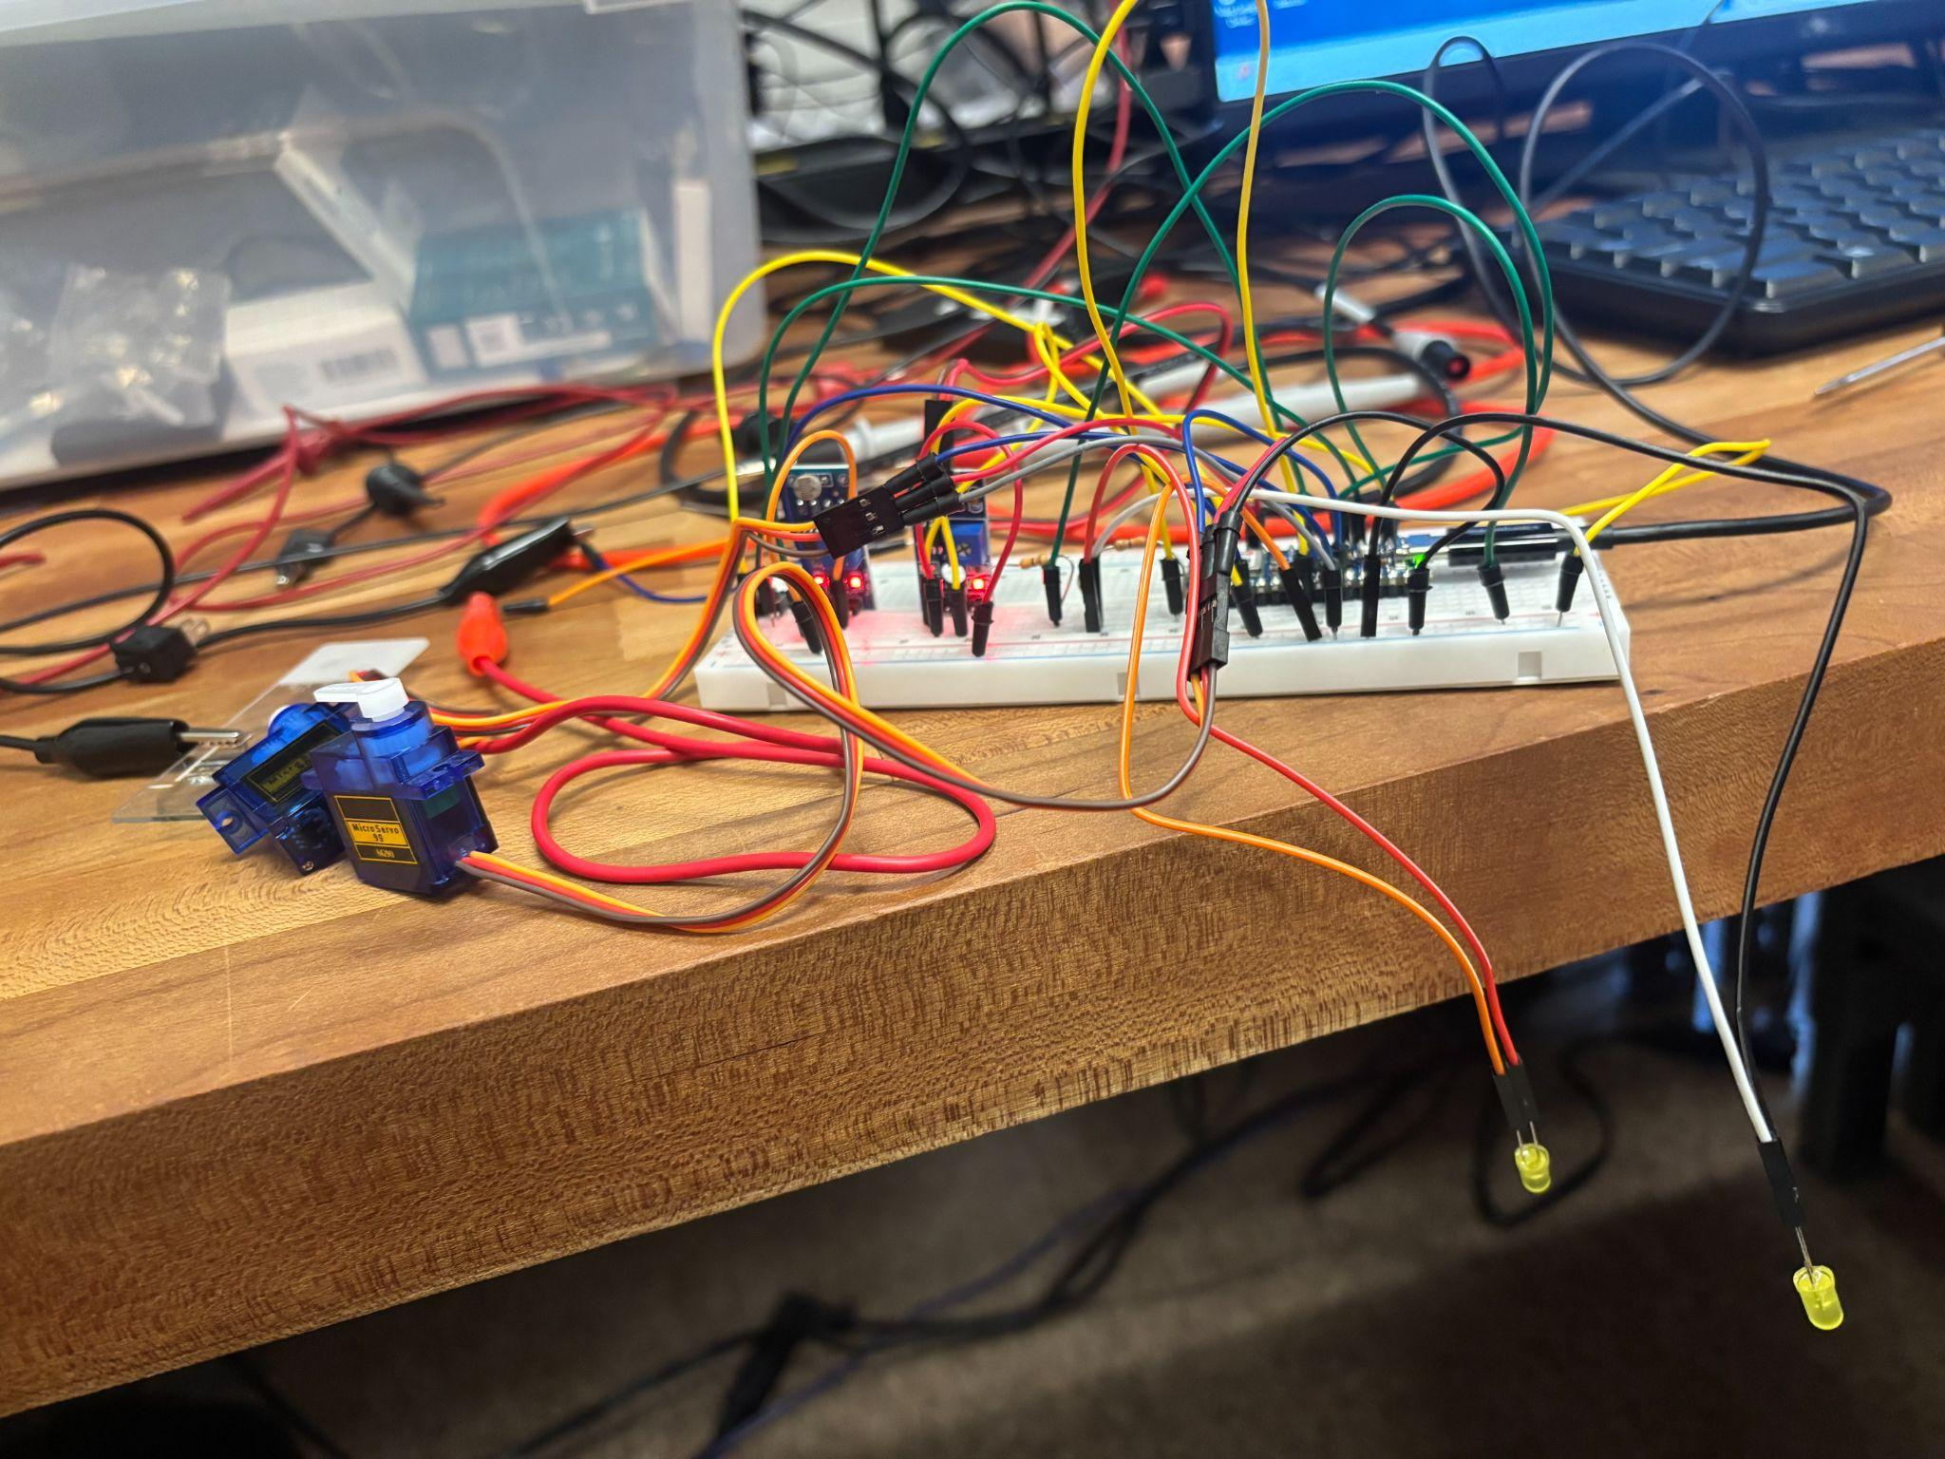
Step 2:
Circuit building
Made basic circuit schematic
Modified basic vapor sensor design
Added our basic light sensor circuit
Added basic button circuit

Slide 11
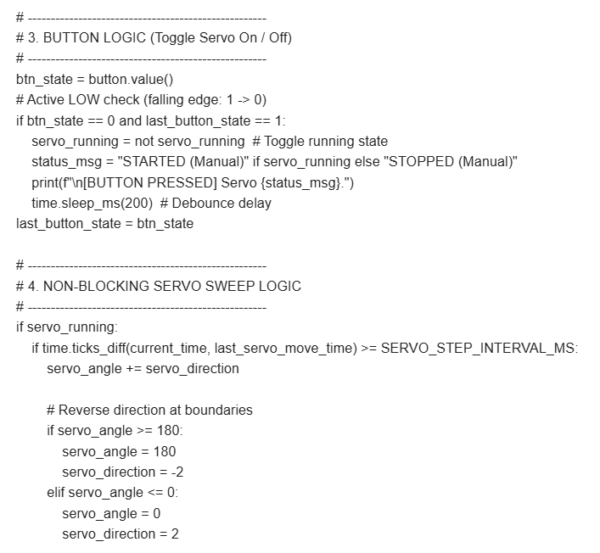
Step 3:
Code writing
Used AI to get diagnostic code for each element (botton, light sensor, vapor sensor, etc.)
Integrated each piece of code one at a time
Tested code with each addition

Slide 12
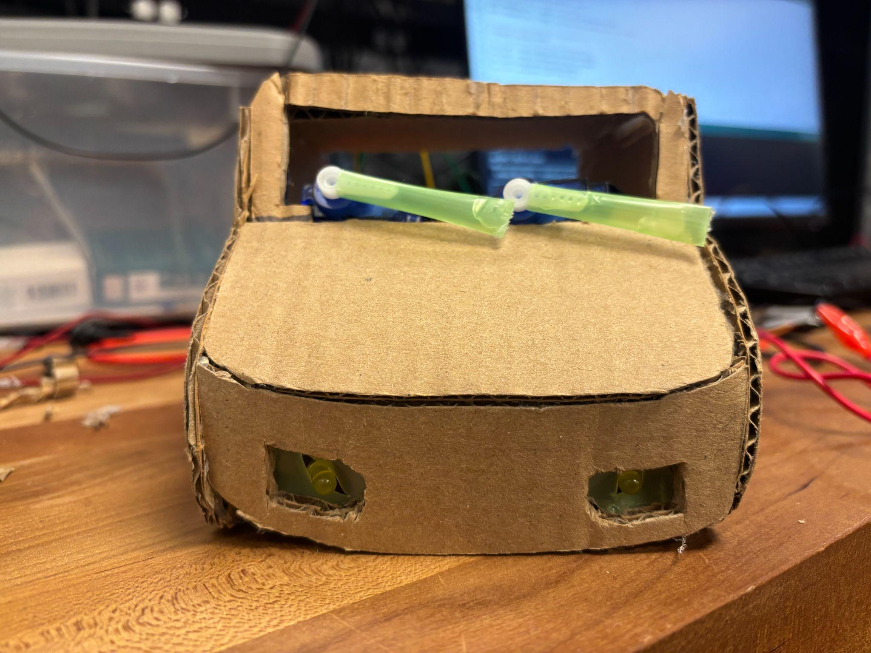
Step 4:
Prototype testing
Built cardboard car model
Taped moving components into prototype
Checked servo motor movement
Tested to find light and vapor sensor threshold

Slide 13
Use of AI

Slide 14

AI wrote and developed all of the code for our project

Slide 15
OUR PROCESS
STEP 01
Create Individual Diagnostics Tests
STEP 03
Troubleshoot
STEP 02
Synthesize Diagnostics

Slide 16
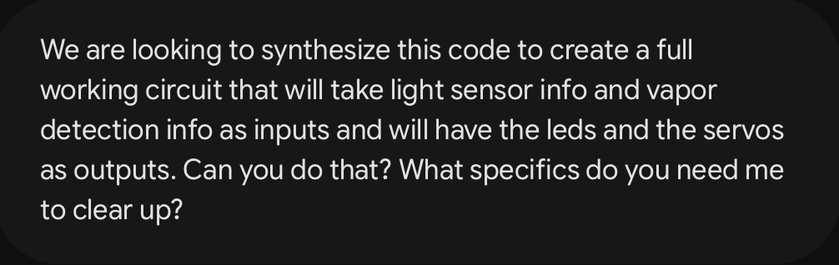

The most important piece to our AI interactions was asking questions.

Slide 17


Through trial and error we eventually created a very reliable program.

Slide 18
Results

Slide 19
Requirements
Results
Evidence
Human interaction
Multiple inputs and outputs
Use AI to help develop the code
Button was key for controlling wipers
LEDs and servos were synchronized
Functional circuit
Started the wipers when vapor sensor glitched
Used same pin on microcontroller
Tested each piece of code before adding it

Slide 20
Successes
Challenges
Inaccurate sensor
Inconsistent vapor detection values
Reliable headlights
Circuit / code accuracy

Slide 21
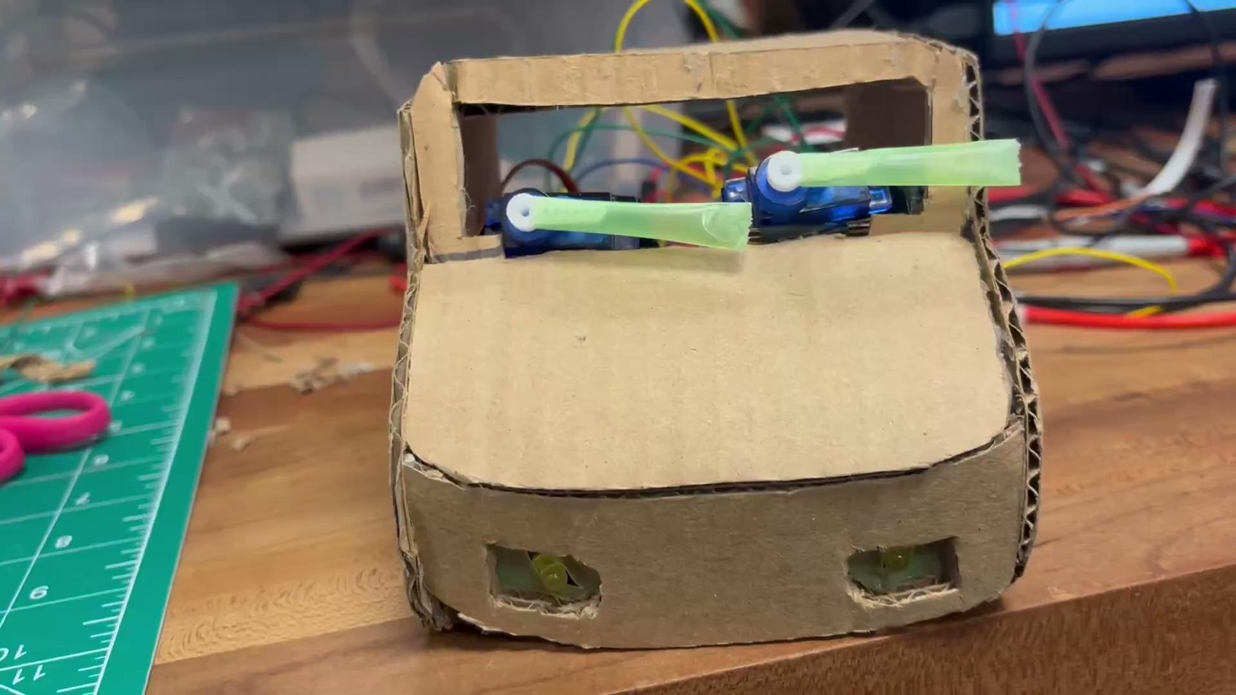

Slide 22
Conclusion

Slide 23
Conclusion
Created a fully functioning prototype
Biggest challenge was with vapor sensor
Learned a lot about the design process
Eventually created a successful prototype

Slide 24


THANK YOU
Any questions?

